Slide 1

Authors: Approved by:
Aprajita - 46281989 Bhimashankar Takalki
RimpiSaha -46281999
Choppa Gowrilatha - 46279726
Tangudu Sowmya - 46279714
Polistti Yamabharathi- 46279725

Slide 2
DO NOT DISTURB IMPLEMENTATION

Slide 3
CONTENT LIST
Abstract
Introduction
Functional Overview
Advantages
Disadvantage
Output
References

Slide 4
ABSTRACT
The main objective of the project is to implement the Do Not Disturb mode in Android to block the incoming calls whenever we are in an important meeting or in Driving or Something more important .

Slide 5
INTRODUCTION
The Do not disturb mode on your mobile phone is used to block the incoming Calls The purpose of the Project is to implement the do not disturb feature which allows you to mute or block the incoming call alerts. With this feature, it's easier to mute/block all calls and alerts for tool like mobile or Androids.

Slide 6
FUNCTIONAL OVERVIEW
The incoming calls can be blocked by the user in two ways either by Selectively mode or Globally mode.
1.Selectively Mode: In Selectively Mode ,we can select few of the contact numbers and the respective incoming calls will be blocked.
2.Globally Mode: In Globally mode all the incoming calls will be blocked by the user.

Slide 7
ADVANTAGES
If someone is in the meeting or driving, they don’t want to get interrupted in middle. so, incoming calls can be blocked by keeping their mobile in the DND mode.
Allows you to register your DND preferences as to what kind of numbers do you want to block or whether you want to block all kind of commercial communication

Slide 8
DISADVANTAGE
In case, if we got any kind of emergency, we cannot connect to that user who has enable DND mode on their mobile. They can not get any kind of message.

Slide 9
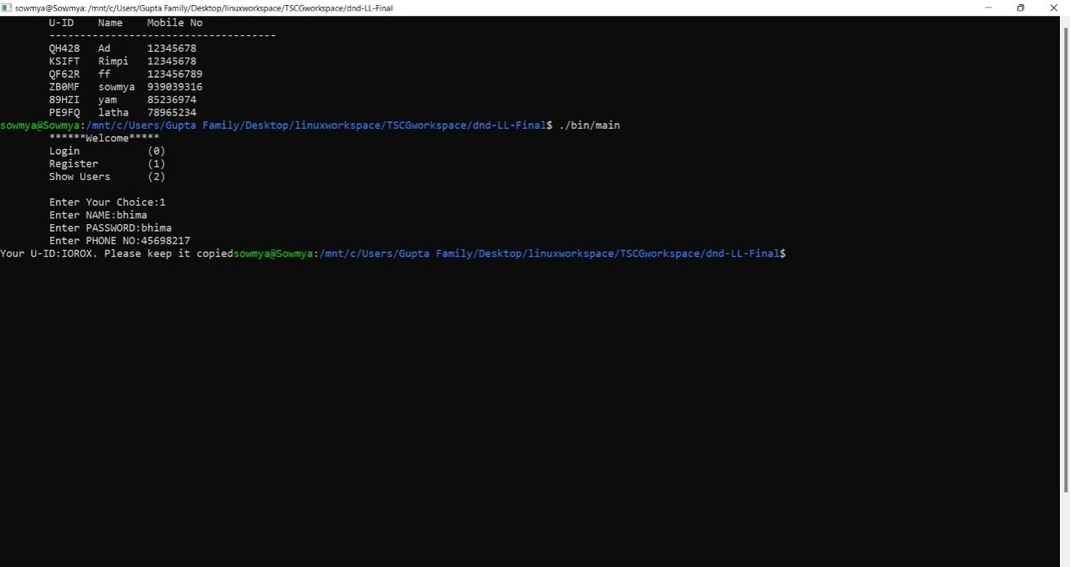
OUTPUT

Slide 10
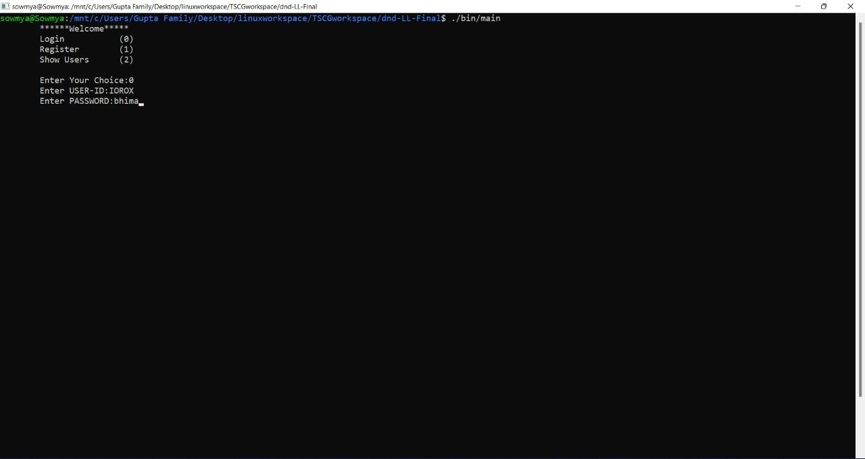

Slide 11
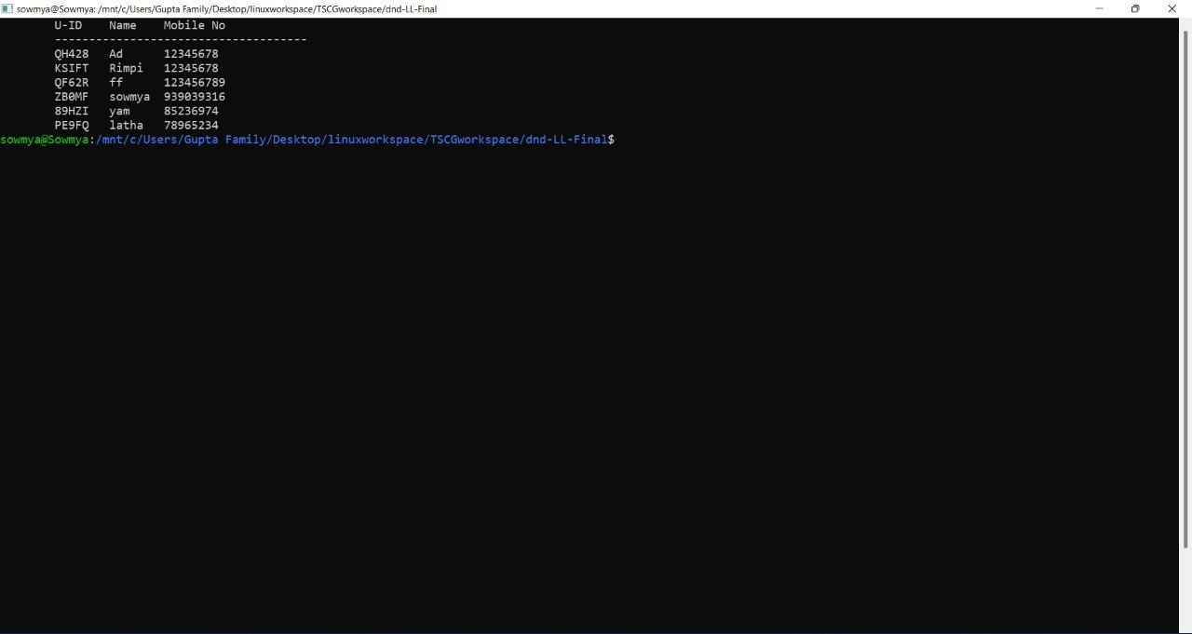

Slide 12
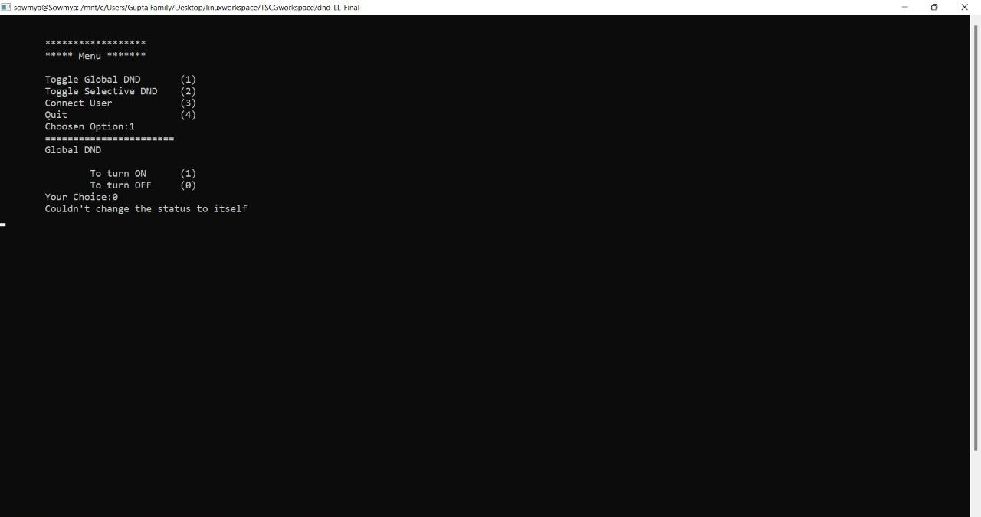

Slide 13
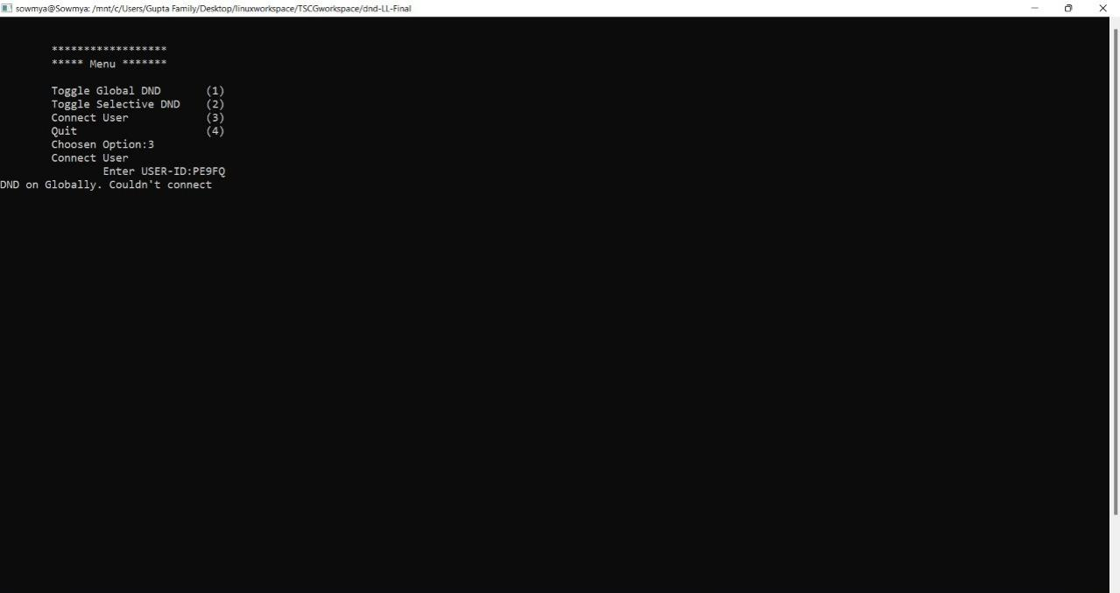

Slide 14
REFERENCE
https://www.codespeedy.com/find-a-specific-file-in-a-directory-in-cpp/ Find a Specific File in a directory.
System Requirements Specification Document
https://linuxhint.com/grep_command_linux/ Grep Command in Linux

Slide 15
𝕋ℍ𝔸ℕ𝕂 𝕐𝕆𝕌

